Slide 1
EFFECTIVE CLASSROOM ASSESSMENTS
Share My Lesson:
Virtual Conference
March 15, 2017 @ 6 PM
Tips for Testing the
Right Skills
Brent Englar
Drew Robison
http://www.wisewire.com/

Slide 2
POLL
Poll
How do you create assessments for students?
I write my own from scratch.
I adapt from existing assessments.
I use exactly what the textbook provides.
I search online for what others have created.
I have never given an assessment before.
Other (please type in the chat box)
Notes:
KELLY: Please convert this into a poll question. Can you make this a multiple select (participants can choose multiple options)? If not, we’ll just tell participants to choose the choice they use most often.

Slide 3
Students who know the content get it right.
Students who don’t know the content get it wrong.

Slide 4
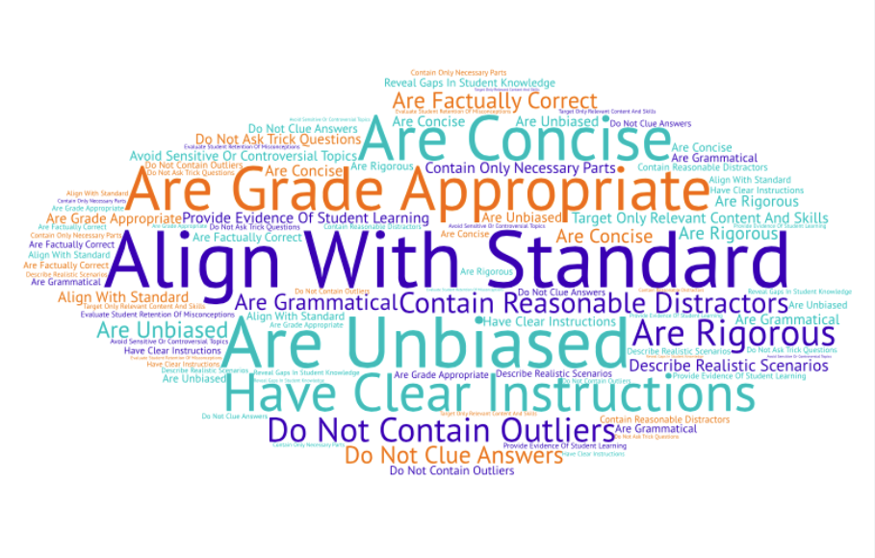
Effective Assessments . . .

Slide 5
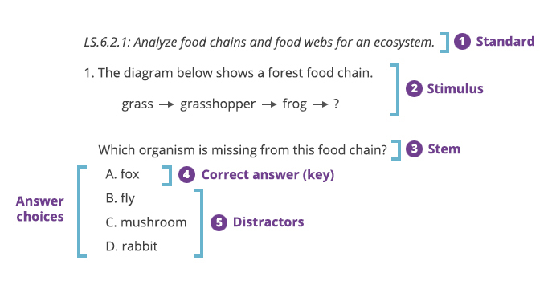
Anatomy of a Multiple-Choice Item

Slide 6
Depth of Knowledge (DOK)
DOK Level 1: Recall and Reproduction
DOK Level 2: Working with Skills and Concepts
DOK Level 3: Short-Term Strategic Thinking
DOK Level 4: Extended Strategic Thinking
Notes:
KELLY, we’d like to provide this resource for participants to learn more about DOK:
Depth of Knowledge “Wheel”: http://static.pdesas.org/content/documents/M1-Slide_19_DOK_Wheel_Slide.pdf

Slide 7
POLL
Poll
Can selected-response items be written at DOK Levels 3 and 4?
No to both
Yes to DOK 3, but no to DOK 4
Yes to both
Notes:
KELLY: Please convert this into a poll question.

Slide 8
Multiple-Choice: Easy or No?
No
Yes
All of the above
None of the above
Notes:
KELLY: To be clear, this is just an image, not a poll ☺

Slide 9
Poll
You want to write a multiple-choice item.
Where do you start?
Dive right in!
Review the standards.
Consider common misconceptions.
Download sample items and tests.
Other (please type in the chat box)
Notes:
KELLY: Please convert this into a poll question.

Slide 10
Know Your Students

Slide 11
Know the Standards
CCSS.ELA-LITERACY.L.4.A.F Produce complete sentences, recognizing and correcting inappropriate fragments and run-ons.

Slide 12
Design the Item
CCSS.ELA-LITERACY.L.4.A.F Produce complete sentences, recognizing and correcting inappropriate fragments and run-ons.
What type of item best assesses this skill?
How rigorous should I make the item?
Should I include a stimulus?

Slide 13
Write the Stem
Which of the following best combines the sentences without changing their meaning?
Drew’s Do
Drew’s Don’t
Stay on target.
Be clear.
Remain objective.
Write trick questions.
Use negative stems.
Use pronouns.
Assess opinions.

Slide 14
Write the Stimulus
Read these three sentences.
People do not speak face-to-face these days. It is easy to communicate using any one of the many types of technology we have today. It is also easy to use social media.
Which of the following best combines the sentences without changing their meaning?
Drew’s Do
Drew’s Don’t
Include directions.
Keep text complexity at or below grade level.
Avoid sensitivity issues.
Use lots of words.
Use unrealistic scenarios, complex units, or dated content.
Introduce bias.

Slide 15
Write the Correct Answer
Read these three sentences.
People do not speak face-to-face these days. It is easy to communicate using any one of the many types of technology we have today. It is also easy to use social media.
Which of the following best combines the sentences without changing their meaning?
KEY: Technology has changed communication because it is much easier to use social media than to speak face-to-face.
Drew’s Do
Drew’s Don’t
Avoid outliers.
Include clues.

Slide 17
Write the Distractors
Read these three sentences.
People do not speak face-to-face these days. It is easy to communicate using any one of the many types of technology we have today. It is also easy to use social media.
Which of the following best combines the sentences without changing their meaning?
Technology has changed communication, social media is more face-to-face.
Technology, changing communication, because it is much easier than always having to be face-to-face.
Technology has changed communicating and it is much easier and we use different types of technology.
Technology has changed communication because it is much easier to use social media than to speak face-to-face.
Drew’s Do
Drew’s Don’t
Include throwaways with no rationale.
All of the above / None of the above
Make them plausible.
Assess common mistakes.

Slide 18
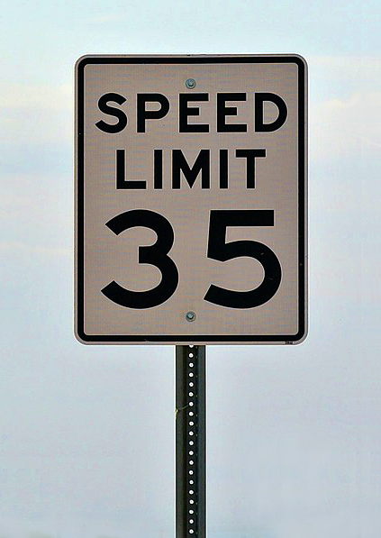
What Are Our Limitations?
Multimedia
Interactivity
Feedback and hints
Demonstrate skills
Notes:
KELLY: Between this and the next slide, we plan to share our screen: http://www.wisewire.com/technology-enhanced-assessment-bank/

Slide 19
Computer-Based Assessments
Easy in Print
Matching
Fill in the Blank
Dropdown
EBSR
Best for Digital
Drag and Drop
Select Text
Hotspot
Graphing and Number Lines
Notes:
KELLY, we’d like to provide this resource for participants to learn more about TEI types:
http://www.wisewire.com/technology-enhanced-assessment-bank/

Slide 20
Start with the Standard
CCSS.MATH.content.HSA-REI.D.12 Graph the solutions to a linear inequality in two variables as a half-plane (excluding the boundary in the case of a strict inequality), and graph the solution set to a system of linear inequalities in two variables as the intersection of the corresponding half-planes.

Slide 21
Questions to Ask
CCSS.MATH.content.HSA-REI.D.12 Graph the solutions to a linear inequality in two variables as a half-plane (excluding the boundary in the case of a strict inequality), and graph the solution set to a system of linear inequalities in two variables as the intersection of the corresponding half-planes.
What type of item best assesses this skill?
How rigorous should I make the item?
Should I include a stimulus?

Slide 22
Write the Stem
CCSS.MATH.content.HSA-REI.D.12 Graph the solutions to a linear inequality in two variables as a half-plane (excluding the boundary in the case of a strict inequality), and graph the solution set to a system of linear inequalities in two variables as the intersection of the corresponding half-planes.
Graph the system of inequalities.
y ≤ 3x + 5
y > –2x – 8
Positive slope
Negative slope

Slide 23
Refine the Stem
CCSS.MATH.content.HSA-REI.D.12 Graph the solutions to a linear inequality in two variables as a half-plane (excluding the boundary in the case of a strict inequality), and graph the solution set to a system of linear inequalities in two variables as the intersection of the corresponding half-planes.
Graph the system of inequalities.
y ≤ 3x + 5
y > –2x – 8
Includes boundary line
Does not include boundary line

Slide 24
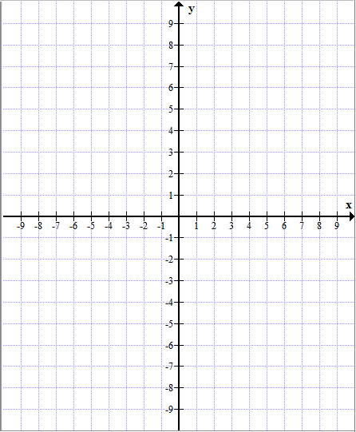
CCSS.MATH.content.HSA-REI.D.12 Graph the solutions to a linear inequality in two variables as a half-plane (excluding the boundary in the case of a strict inequality), and graph the solution set to a system of linear inequalities in two variables as the intersection of the corresponding half-planes.
Graph the system of inequalities.
y ≤ 3x + 5
y > –2x – 8

Slide 25
Put It to the Test!
Notes:
KELLY: Between this and the next slide, we plan to share our screen: https://platform.wisewire.com/question/ccss-hsa-rei-d-12-gra-11-no-context/f8821594-6720-40b8-bafc-de28dd50c7d8#

Slide 26
POLL
Poll
What is the DOK Level of the graphing item we just built?
DOK Level 1
DOK Level 2
DOK Level 3
DOK Level 4
Notes:
KELLY: Please convert this into a poll question.

Slide 27
PARCC & SBAC

Slide 28
Thank You!
Any questions?
Teacher Sign Up: www.wisewire.com/user-login
Follow Us:
Join Us:
@WisewireEd
/WisewireEd
/Wisewire
Wisewire Ed
Notes:
KELLY: Please provide the moderator with the following “seed” questions:
Could you show us another type of computer-based assessment item?
What if my students don’t have regular access to computers --- are there paper-and-pencil equivalents for all types of tech-enhanced items?
You said that if an assessment is effective, students who don’t know the content will get the answer incorrect --- but won’t some students always guess correctly?

